Slide 1
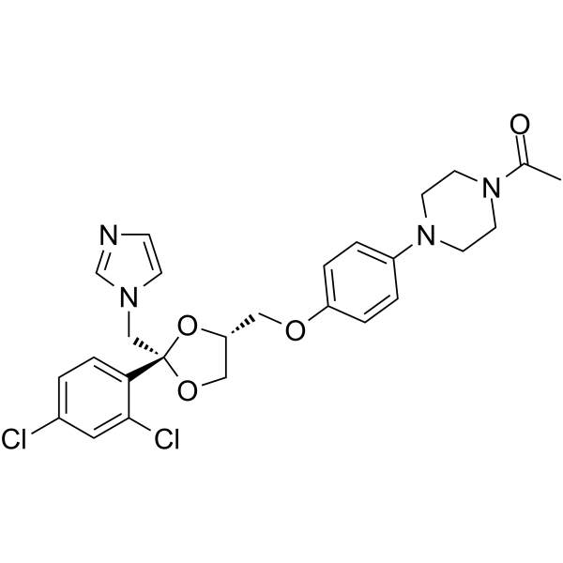
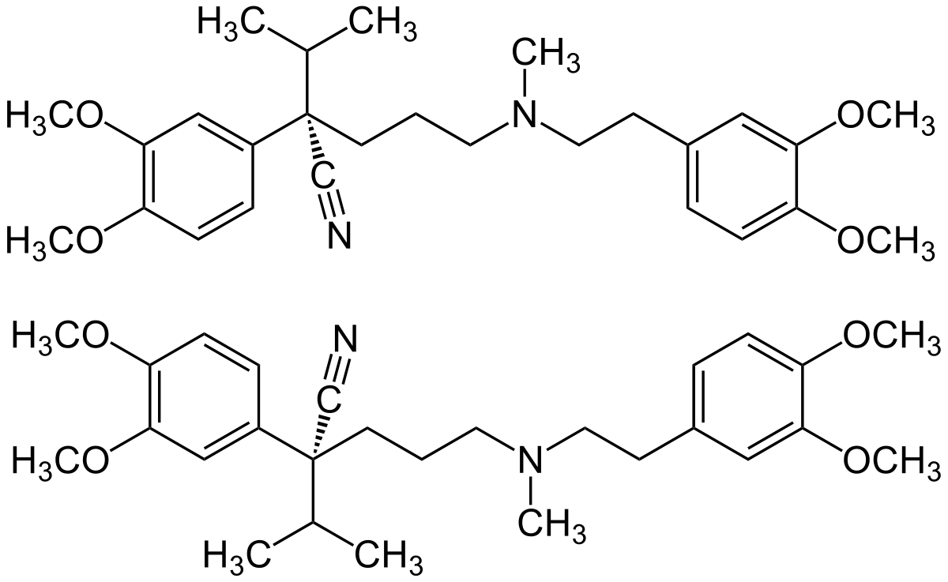
,
Ketoconazole and verapamil cause the reduction of heme
Kondža M^{1,5}, Kerleta-Tuzović V^{2,3,5}, Dautović E^{3,5}, Zovko A^{4,5}
¹University of Mostar, Faculty of Pharmacy, Matice hrvatske bb, 88000 Mostar, Bosnia and Herzegovina
²Agency for Healthcare Quality and Accreditation in FB&H, Dr. Mustafe Pintola 1, 71000 Sarajevo
³University of Tuzla, Faculty of Pharmacy, Univerzitetska 8, 75101 Tuzla
⁴AFARM Pharmacies, Ante Starčevića 19, 88220 Široki Brijeg, Bosni and Herzegovina
⁵Pharmaceutical Chamber of FB&H, Zagrebačka bb, 71000 Sarajevo, Bosnia and Herzegovina
1. INTRODUCTION
600 nm was recorded on a spectrophotometer. The incubation mixture was prepared to a volume of 1.5 mL and consisted of ultrapure water, appropriate hemin solution, 0.83 M pyridine (final concentration) and 0.06 M sodium hydroxide (final concentration). The prepared calibration curve was used to calculate the heme concentration in the samples. The incubation mixture was prepared according to the described method.
Ketoconazole is an antiandrogen and antifungal medicine used to treat certain serious fungal infections in the body. Verapamil is a calcium channel blocker medicine used to treat patients with high blood pressure, angina and supraventricular tachycardia. Cytochrome P450 3A4 (CYP3A4) enzymes are a part of a large group of enzymes with a hem prostetic group, which are essential for the metabolism of many medicines and endogenous compounds. CYP3A4 is responsible for the metabolism of more than 50% of medicines. CYP3A4 is subject to reversible and mechanism-based (irreversible) inhibition. The latter involves the inactivation of the enzyme via the formation of metabolic intermediates that bind irreversibly to the enzyme and then inactivate it. Ketoconazole and verapamil are known as strong inhibitors of the CYP3A4.
4. RESULTS
An 83.72% and a 69.92% reduction of heme was observed using ketoconazole and verapamil as substrates. The second testing with superoxide dismutase and catalase showed similar results with 77.34% and 58.23% of heme reduction, respectively. These results indicate the irreversible nature of the CYP3A4 inhibition by ketoconazole and verapamil and are useful for future clinical practices and drug regulations.
Figure 1. Ketoconazole
Figure 2. Verapamil
2. AIMS
The aims of the present study were to determine the effect of ketoconazole and verapamil on the hem concentration and to observe the changes in the concentration regarding the CYP3A4 enzyme.
3. METHOD
The examination of the change in heme concentration due to binding to the reactive intermediate to heme was performed according to the method described earlier in the literature. To perform the test, the calibration curve of the hemin solution in dimethyl sulfoxide (0.6 to 0.1 μM) was first prepared, and a spectrum at a wavelength of 500 to
5. CONCLUSIONS
Ketoconazole and verapamil are known CYP3A4 inhibitors. In this study a change in the heme concentration was observed. Clinicans, health specialists and drug manufactureres should be aware of this significant heme reduction due to binding of the reactive intermediate.
6. REFERENCES
Kondža, Martin; Bojić, Mirza; Tomić, Ivona; Maleš, Željan; Rezić, Valentina; Ćavar, Ivan. Characterization of the CYP3A4 Enzyme Inhibition Potential of Selected Flavonoids // Molecules, 26 (2021), 10; 3018, 13 doi:10.3390/molecules26103018.
Bojić, M., Barbero, L., Dolgos, H., Freisleben, A., Gallemann, D., Riva, S., Guengerich, F. P. (2014). Time-and NADPH-dependent inhibition of cytochrome P450 3A4 by the cyclopentapeptide cilengitide: Significance of the guanidine group and accompanying spectral changes. Drug Metabolism and Disposition, 42(9), 1438-1446.

